Slide 1

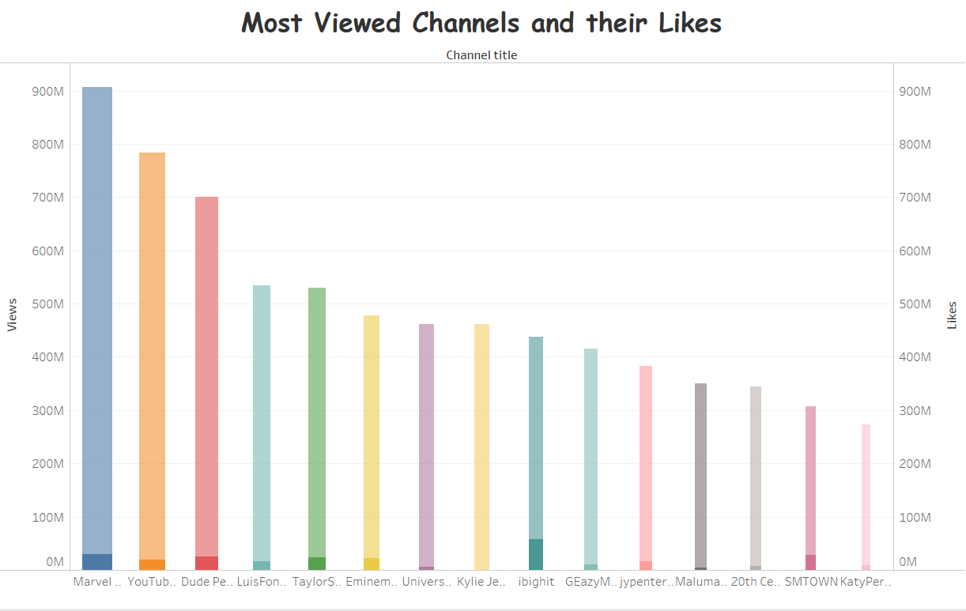
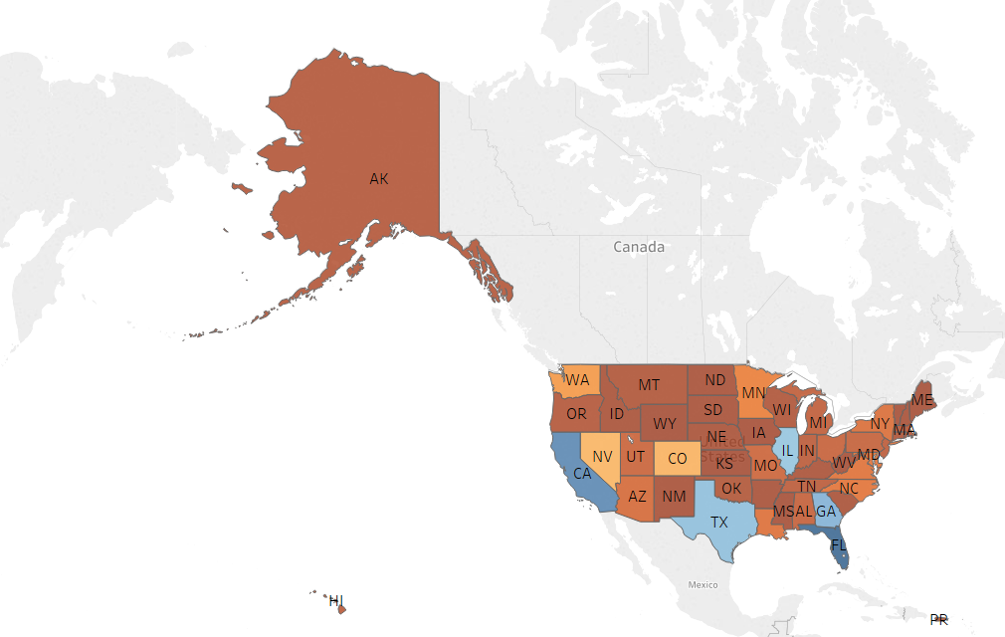
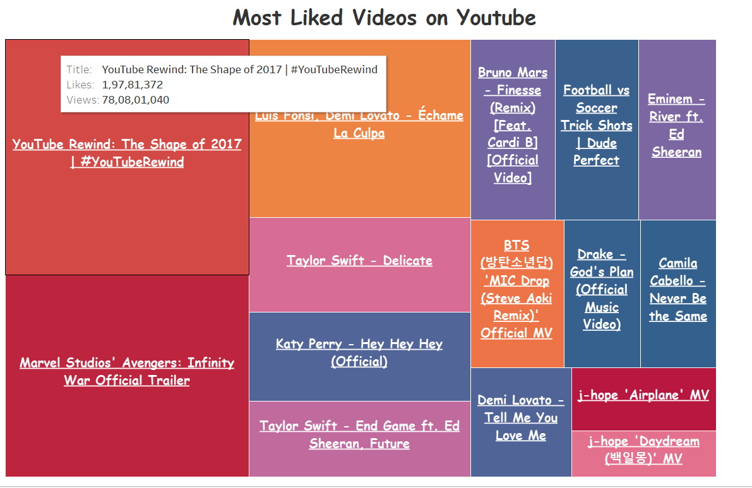
Youtube Video Statistics

Slide 2
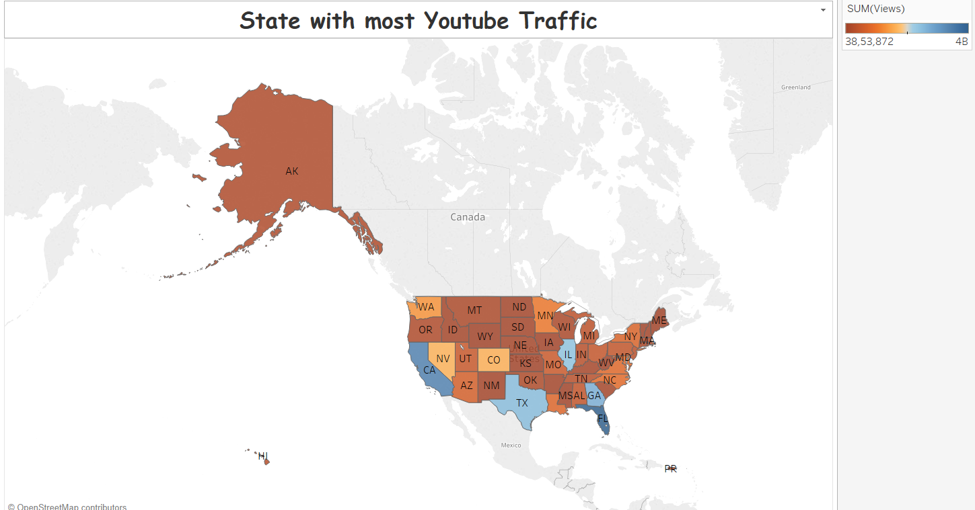
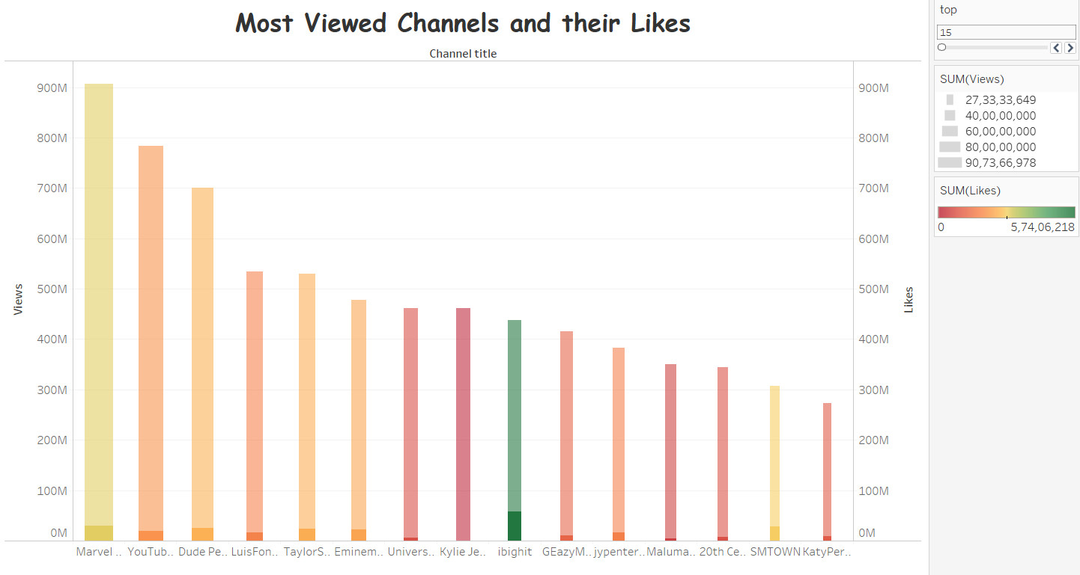
State with most Youtube Traffic
Most Viewed Channels and their Likes
This graph depicts the youtube traffics among different states of USA, Florida has the maximum youtube traffic.
It is a map plot which uses orange-blue diverging color scheme
This graph shows the most popular channels on youtube . Apparently Marvel Entertainment is the most viewed channel.
The light part of the bar shows the number of views whereas the dark part of the bar shows the number likes on that channel. The plot is dynamic as the number of channels can be changed using the slider

Slide 3
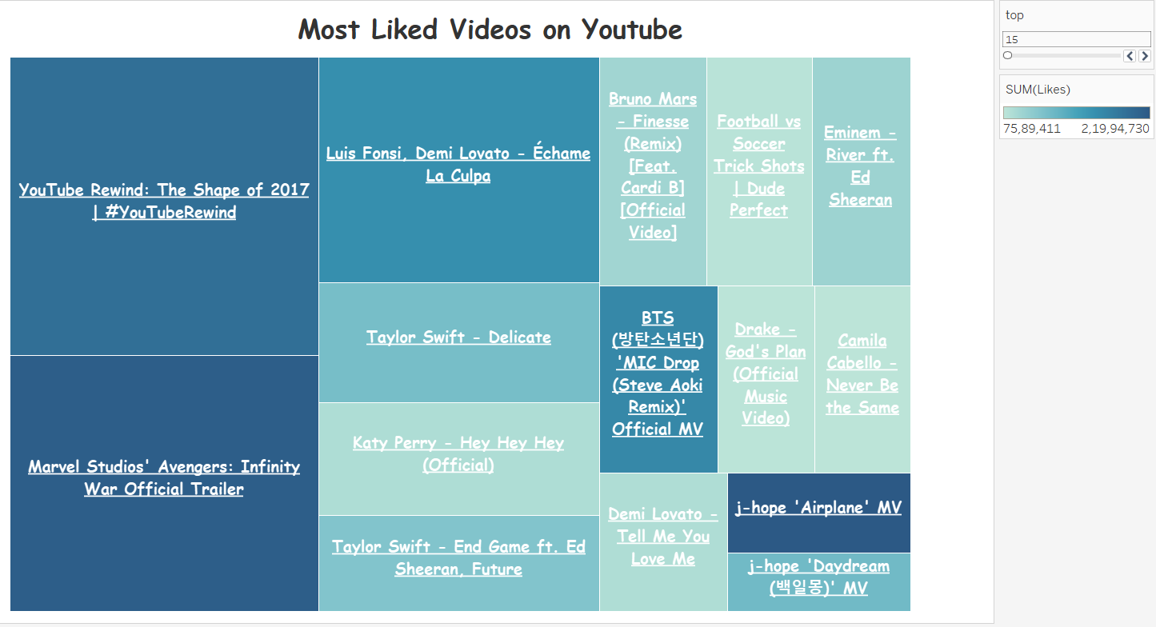
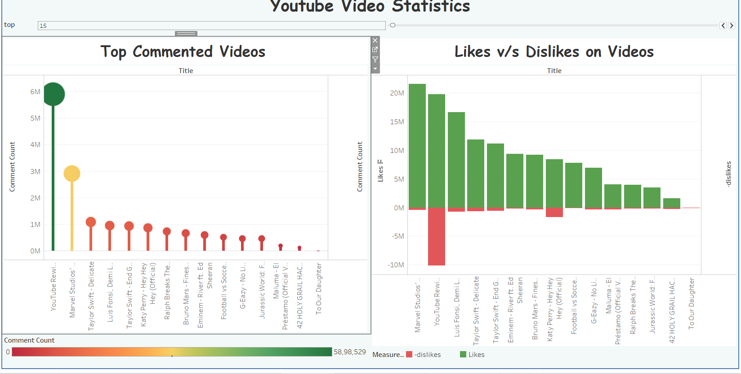
Avenger’s infinity war trailer was most liked video on youtube
This is an area chart in which size depends on the number of views and color on likes. Also dynamic as it can toggled using the slider for more videos
Color scheme – Sunset-Sunrise Diverging
Final dashboard uses o charts lollipop chart and 2 way bar-graph also is dynamic and can be toggled using the slider main sheet is the top commented videos and controls the the other sheet by highlighting the info about the hovered lollipop on the graph itself

Slide 4
Resources and links to the dashboard
Dashboard link :- https://public.tableau.com/profile/aurobind.singh#!/vizhome/youtubevideostatistics/Dashboard1
Also I am giving you the actual workbook too as I use tableau desktop and my tableau public shows only the dashboard on it not the worksheets

